Slide 1
Chapter 1
What is sociology
Sociology is the systematic and objective study of human society and social interaction.
Sociologists use research techniques similar to those of the natural sciences. They often conduct research using scientific method. That is, they establish testable hypotheses and decide ahead of time which results will lead them to accept or reject the hypotheses. Like other scientists, sociologists strive to reach conclusions and present findings that are objective—not biased by emotion or preferences. It is this commitment to scientific methods that makes sociology different from the nonscientific disciplines of the humanities.

Slide 2
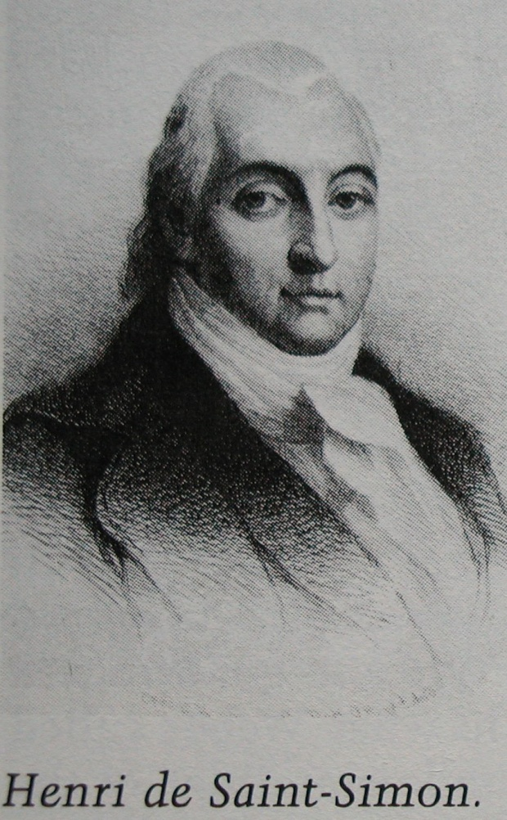
The history and development of sociology
Henry de Saint-Simon(1760-1821)
  He was the first scholar to treat society as a distinct and separate unit of analysis. He also was one of first to stress the idea that the social sciences might use the new methods of the natural sciences. But like most of the early social thinkers who followed the Industrial Revolution, Saint-Simon was interested in the analysis of society only as it related to his desire for social reform.

Slide 3
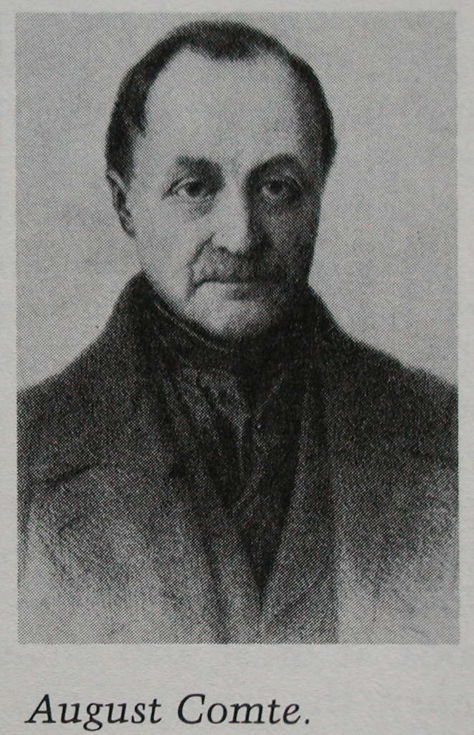
August Comte(1798-1857)
He was considered the founder of sociology. He had once been personal secretary to Saint-Simon. Comte coined the term sociology. Previously, he had called the discipline “positive philosophy”( social physics ), both to stress its scientific nature and to distinguish it from traditional philosophy. The aim of sociology, as he saw it, was to find the “invariable laws” of sociology upon which a new order could be based.

Slide 4
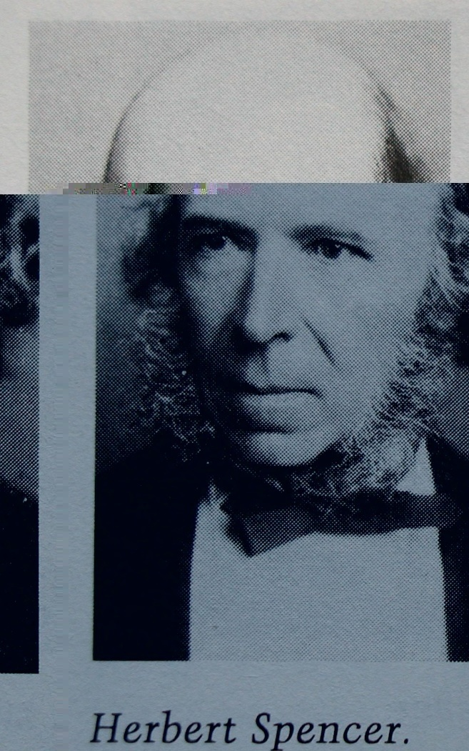
Herbert Spencer
Spencer (1820-1903) put the idea that society is like an organism—a self-regulating system. Drawing an analogy to Charles Darwin’s theory of biological evolution, Spencer suggested that societies, like animal species, evolved from simple to more complex forms. Spencer was an early advocate of what later came to be called Social Darwinism—the view that the principle of survival of the fittest applies to societies and within societies.
    Earthworm------->dog

Slide 5
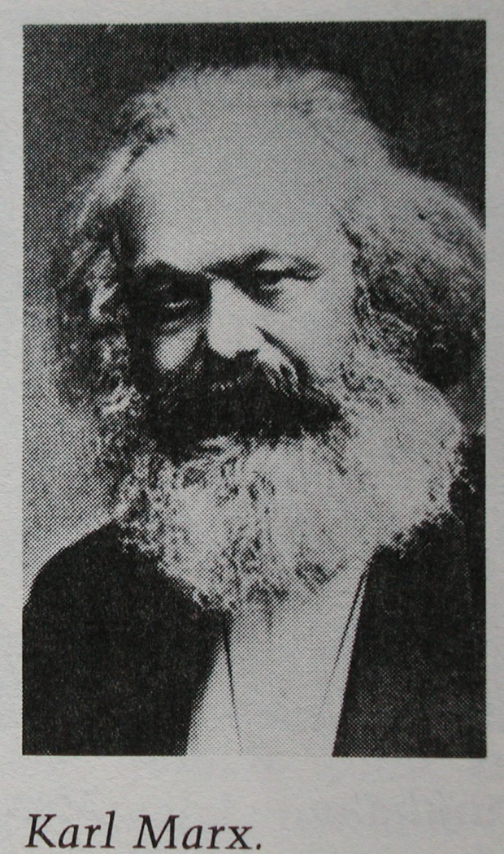
Karl Marx(1818-1883)
In contrast to Spencer’s view that societies are subjected to “natural” laws, Marx believed that societies follow historical laws determined by economic forces. He saw human history as a series of inevitable conflicts between economic classes.
Marx’s view on class conflict are reflected in the conflict school of modern sociology
  Primitive society →slavery → feudalism→ capitalism → communism
  Productivity
  Economic base and superstructure

Slide 6
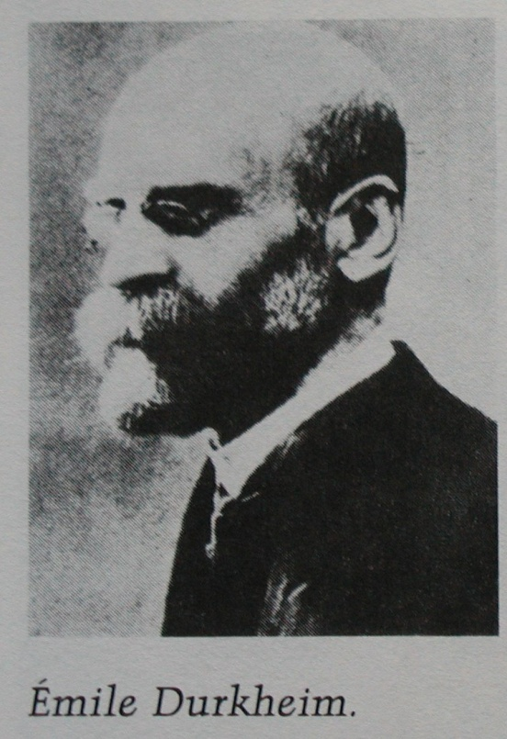
Emile Durkheim(1858-1917)
More than anyone, the French scholar Emile Durkheim defined the subject matter of sociology and pointed out how it differed from philosophy, economics, psychology, and social reform. In The Rules of Sociological Method (1894) and in Suicide (1897), Durkheim argued that the main concern of sociology should be what he called social facts. In contrast to those who reduce most social phenomena to individual psychological and biological traits, Durkheim felt that the main building blocks of societies are laws, customs, instititions, and organizations.

Slide 7
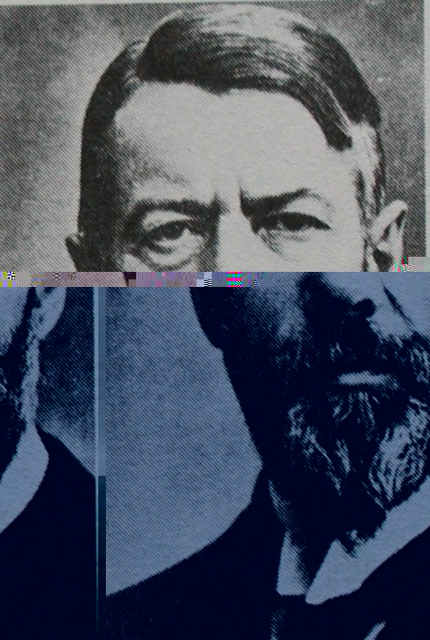
Marx Weber(1864-1920)
Weber was perhaps the greatest single influence on modern sociology. He was particularly interested in the larger dimensions of society—its organizations and institutions—which he studied on a vast historical and worldwide scale. He is perhaps best known for his bureaucracy and capitalism. Much of Weber’s thought contrasts strongly with that of Marx. Weber argued that sociology should include the study of “social action”.

Slide 8
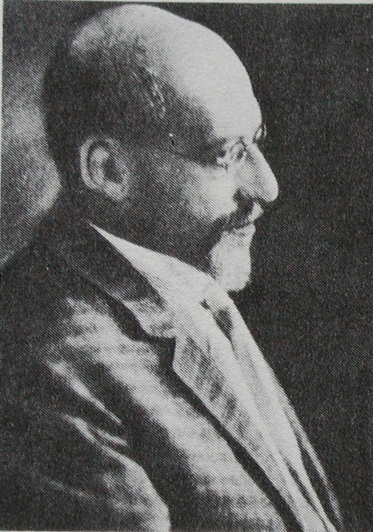
George Simmel(1858-1918)
Unlike the other theorists we have discussed, who were interested in studying the larger structures of society, Gorege Simmel focused on smaller social units. He put forth the idea that society is best seen as a web of patterned interactions among people. He also believed the main purpose of sociology should be to examine the basic forms that that these interactions take. Some examples of the basic forms of interaction that Simmel analyzed are cooperation and conflict, leaders and followers, and the process of communication.

Slide 9
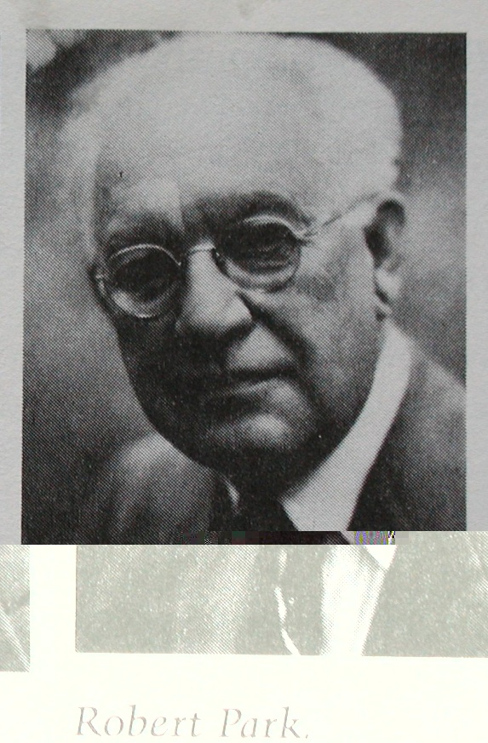
Development of American Sociology
Chicago School
  Sociology first became an established discipline in the Midwest. The sociologists at the University of Chicago during this period came to be known collectively as the “Chicago School”. They were interested in such typical American social problems as ghettos, immigration, race relations, and urbanization. They assembled a vast amount of useful statistical data and developed many important concepts that are still in use.

Slide 10
Robert Park
The leading figure at the University of Chicago was Robert Park (1864-1944), who began teaching there in 1914. Park was a unique combination of news reporter, social activist, researcher, and pure theorist. He combined the perspectives of biology, conflict theory, and the sociology of Gorge Simmel into the first major introductory textbook in sociology. Many of his students later became influential sociologists at other American universities.

Slide 11
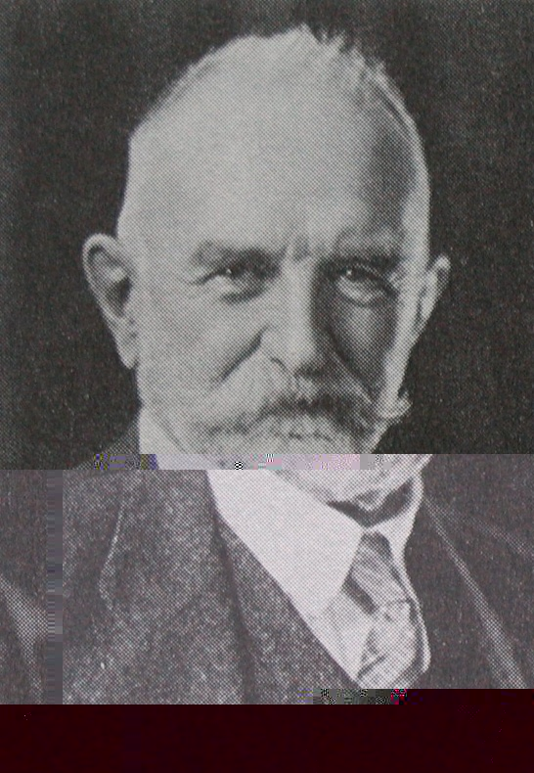
Gorge Herbert Mead
Gorge Herbert Mead (1863-1931) was the major theorist of the symbolic interactionist branch of sociology that was born at the University of Chicago. Mead stressed that humans respond to abstract meanings as well as to concrete experience. Unlike most theorists of the time, Mead claimed that the human mind and self-consciousness are largely social creations. Thus he helped to define that aspect of sociology that sees individual behavior as the product of society.

Slide 12
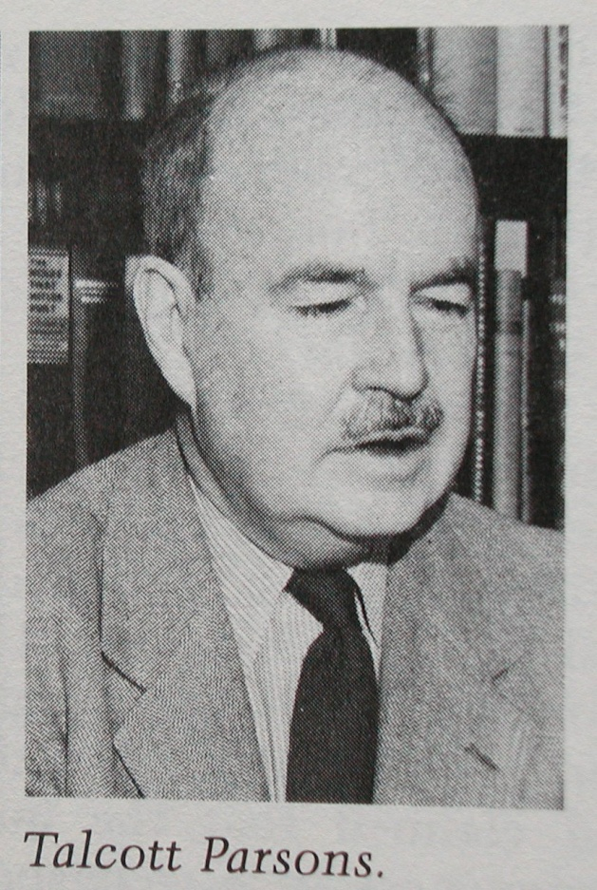
Sociological theories (1)
The functionalist perspective
  It emphasizes the way in which each part of society contributes to the whole so as to maintain social stability. According to this perspective, society is like the human body or any other living organism. Like the parts of the body (such as the limbs, the heart, and the brain), the parts of society (such as families, businesses, and governments) function together in a systematic way that is usually good for the whole. Each part helps to maintain the state of balance that is needed for the system to operate smoothly.

Slide 13
Sociological theories (2)
The conflict perspectives
  It emphasizes conflict as a permanent aspect of societies and a major source of social change. This perspective is based on the assumption that the parts of society, far from being smoothly functioning units of a whole, actually are in conflict with one another. This is not to say that society is never orderly—conflict theorists do not deny that there is much order in the world—but rather that order is only one outcome of the ongoing conflict among society’s parts and that it is not always the natural state of things.
  Conflict theorists trace their roots back to Marx and Simmel. They stress the dynamic, ever-changing nature of society. To them, society is always in a fragile balance. More often than not, social order (often quite temporary) stems from the domination of some parts of society over other parts rather than from the natural cooperation among those parts. Order is the product of force and constraint—domination—of the powerful over the weak, the rich over the poor.

Slide 14
Sociological theories (3)
The interactionist perspective
  It focuses on how people interact in their everyday lives and how they make sense of their social interaction. Interactionists do not see society as such a controlling force, at least not to the degree that the macrosociologists do. Interactionists stress that people are always in the process of creating and changing their social worlds. Interactionists explore people’s motives, their purposes and goals, and the ways they perceive the world.

Slide 15
Three perspectives—a summary
Perspective | Central concern |  | Scope of theorizing | Typical concepts | Some proponents
Fuctionalist | How parts contribute to workings of total society or institutions |  | Maro-level | Manifest functions, latent functions, dysfunctions | Durkeim Parsons Merton
Conflict | Social conflict and inequalities; why they arise and how they are maintained, |  | Maro-level | Class struggle, self-interests, domination of some social groups | Marx Dahrendorf Collins
interactionist | Everyday encounters between people and the symbols by which they are interpreted |  | microlevel | Definition of the situation, Looking glass self | Mead Cooley Goffman

Slide 16
Chapter 2
Culture and Social Structure
Culture refers to the social heritage of a people—those learned patterns for thinking, feeling, and acting that are transmitted from one generation to the next, including the embodiment of these patterns in material items. It includes both nonmaterial culture—abstract creations like values, beliefs, symbols, norms, customs, and institutional arrangements—and material culture—physical artifacts or objects like stone axes, computers, loincloths, tuxedos, automobiles, paintings, hammocks, and domed stadiums.
Society refers to a group of people who live within the same territory and share a common culture. Very simply, culture has to do with the customs of a people, and society with the people who are practicing the customs. Culture provides the fabric that enables human beings to interpret their experiences and guide their actions, whereas society represents the networks of social relations that arise among a people.

Slide 17
Components of culture
Norms
  Norms are social rules that specify appropriate and inappropriate behavior in given situations. They tell us what “should”, “ought”, and “must” do, as well as what we “should not”, “ought not” and “must not” do. In all cultures, the great body of rules deal with such matters as sex, property, and safty.
  Values
  values are broad ideas regarding what is desirable, correct, and good that most members of a society share. Values are so general and abstract that they do not explicitly specify which behaviors are acceptable and which are not. Instead, values provide us with criteria and conceptions by which we evaluate people, objects, and events as to their relative worth, merit, beauty, or morality.

Slide 18
Components of culture
Symbols and language
  Symbols are acts or objects that have come to be socially accepted as standing for something else. They come to represent other things through the shared understanding people have.
  Language is a socially structured system of sound patterns (words and sentences) with specific and arbitrary meanings. Language is the cornerstone of every culture. Its is the chief vehicle by which people communicate ideas, information, attitudes, and emotions to one another. And its is the principal means by which human beings create culture and transmit it from generation to generation.

Slide 19
Social structure (1)
Statuses
  A status is a socially defined position in a group or society. Being female, black, a lawyer, or a rather is a status. There are two types of statuses. A status can be gained by a person’s direct effort, usually through competition, is called an achieved status. Most occupational positions in modern societies are achieved statuses. A social position to which a person is assigned according to standards that are beyond his or her control—usually parentage, age, and sex—is called ascribed status.

Slide 20
Social structure (2)
Role
  A role is the behavior expected of someone with a given status in a group or society. According to Ralph Linton (1936), one occupies a status, but plays a role.
  There is sometimes a difference between the way a role is written in society’s script and the way people play that role. The role expectation, society’s definition of the way a role ought to be played, does not always match role performance, the way a person actually plays a role.
  In the course of one day’s social interaction, a person must play many different roles. If opposing demands are made on a person by two or more roles, the situation is called role conflict. Sometimes, opposing demands are built in into a single role; the personal stress caused by such opposing demands of a single role is called role strain (Good, 1960).

Slide 21
Social structure （3）
Group
  Statuses and roles are building blocks for more comprehensive social structures, including groups. Sociologists view a group as two or more people who share a feeling of unity and who are bound together in relatively stable patterns of social interaction.
  A group is more than a collection of people. Sociologists distinguish it from an aggregate, which is simply a collection of anonymous individuals who are in one place at the same time. Shoppers in a mall, individuals waiting in line for football tickets, and audience at a concert, and a crowd watching a hockey game are examples of aggregates.
  A group also differs from a category, a collection of people who share a characteristic that is deemed to be of social significance. Common categories include age, race, sex, occupation, and educational attainment.

Slide 22
Social Structures (4)
Institutions
  Sociologists view institutions as the principal instruments whereby the essential tasks of living are organized, directed, and executed. Each institution is built about a standardized solution to a set of problems. The family institution has as its chief focus the reproduction, socialization, and maintenance of children; the economic institution, the production and distribution of goods and services; the political institution, the protection of citizens from one another and from foreign enemies; the religious institution, the enhancement of social solidarity and consensus; and the educational institution, the transmission of the cultural heritages from one generation to the next.

Slide 23
Social structure (5)
Societies
  A group of people who live within the same territory and share a common culture. By virtue of this common culture, the members of a society typically possess similar values and norms and a common language. Its members perpetuate themselves primarily though reproduction and comprise a more or less self-sufficient social unit. A society can be as small as a tribal community of several dozen people and as large as modern nations with millions of people.

Slide 24
  Sociologists have classified societies in a good many ways. One popular approach is based on the principal way in which the members of a society derive their livelihood. Clearly, survival confronts all peoples with the problem of how they will provide for such vital needs as food, clothing , and shelter.
    Hunting and gathering societies represent the earliest form of organized social life. Individuals survive by hunting animals and gathering edible foods. These societies are constantly on the move and small, consisting of about fifty or so members. Kinship is the foundation for most relationships.
    Some ten thousand or so years ago, human beings learned how to cultivate a number of plants on which they depended for food. The digging stick, and later the hoe, provided the basis for horticultural societies. Horticulturalists clear the land by means of “slash and burn” technology, raise crops for two to three yeas, and then move on to new plots as the soil becomes exhausted. Their more efficient economies allow for the production of a social surplus—goods and services over and above those necessary for human survival. This surplus becomes the foundation for social stratification.

Slide 25
  Five to six thousand yeas ago, in fertile river valleys such as those of the Middle East, the plow heralded an agricultural revolution and the emergence of agrarian societies. Innovations meant larger crops, more food, expanding populations, and even more complex forms of social organization. In time sophisticated political institutions emerged, with power concentrated in the hands of hereditary monarchs.
  About 250 years ago, the Industrial Revolution gave birth to industrial societies whose productive and economic systems are based on machine technologies. The energy needed for work activities came in increasingly from hydroelectric plants, petroleum, and natural gas rather than from people and animals. Economic self-sufficiency and local market systems were displaced by complex divisions of labor, exchange relationships, and national and international market systems.
  Some social analysts contend that the United States is currently moving in the direction of a postindustrial society (Bell, 1973). Other metaphors have been applied to the new and revolutionary patterns, including Alvin Toffler’s (1980) third wave and John Naisbitt’s (1982) megatrends .

